Slide 1
COMP 1537
Node.js & Express

Slide 2
Intro to Node.js
What is it?
A (mostly) server-side run-time environment for web content delivery
It uses an "event-driven architecture"
Fancy way of saying that it responds to events – just like a Graphical User Interface (GUI)
Ryan Dahl wrote it in 2009
He used "Google's V8 JavaScript engine, an event loop, and a low-level I/O API"
Lotsa modules!
Via Node Package Manager (NPM) – see: https://www.npmjs.com/
Non-blocking functions
A call is made and the main execution returns immediately
We’ll look at what this means in a bit …

Slide 3
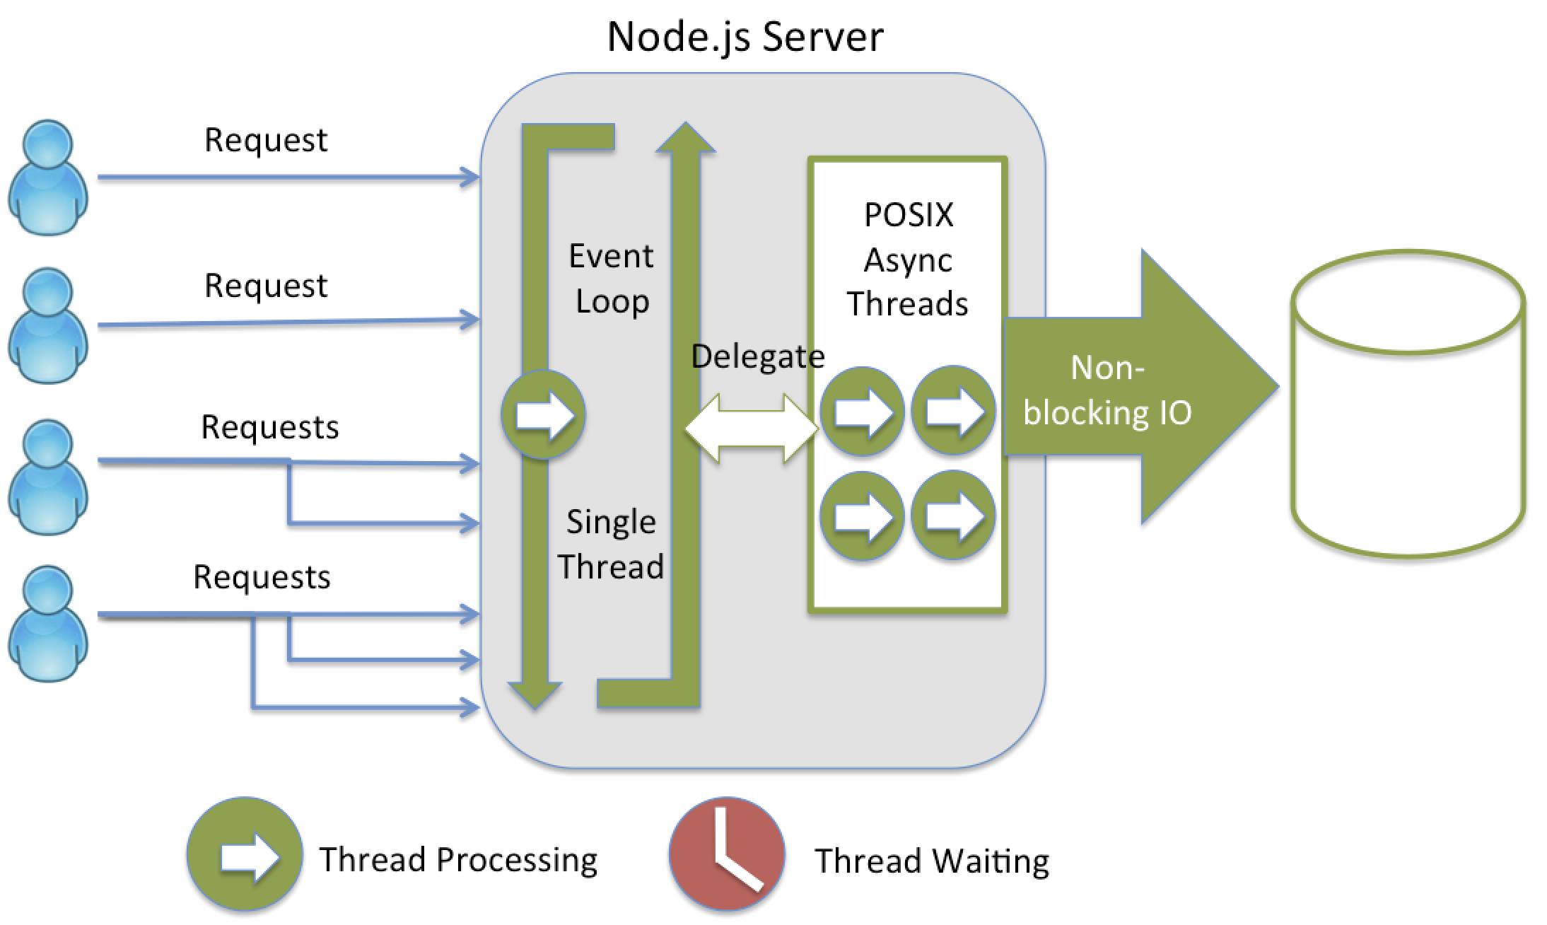
How Node works (1/2)

Slide 4
How Node works (2/2)
About POSIX threads:
IEEE POSIX 1003.1c standard (1995)
A type of light weight process
Comes from the Unix world, is a standard
Event driven
The server waits for requests, doing nothing until a request is made
This is not uncommon to GUIs such as iOS, Android, and any desktop OS

Slide 5
Who's Using It?
Groupon
LinkedIn
Medium
Netflix
PayPal
Trello
Uber
Walmart

Slide 6
Node.js Strengths
High input/output (IO) requirements
E.g., text chat, video/audio streaming, high frequency of transaction processing
One language on front end (Browser/mobile app) and server (Node.js)
Less memory load on developers
Many, many modules – there's a module for everything!
Very lightweight – compared to Java EE
Easy to integrate with front-end frameworks

Slide 7
Node.js Drawbacks
Not as mature of a technology
Java EE/ASP.Net/PHP have been around for 20+ years
So they are much more mature/stable/common/sought after
The architecture can grind to a halt with heavy computation
i.e., the CPU is throttled (e.g., Neural Network (NN) computations)
It's easy to write really bad code
e.g., "callback hell"

Slide 8
“Require” a Module
What is “require”?
A function that we can call
It gets other JS modules that have been written
It can be used anywhere in your code – not just at the top of your code file
Unlike a Java import, or using in C# - require is not a directive, it’s a function
Require executes the JS code
The JS code is treated as an object – which may have other objects & functions attached to it

Slide 9
What is a Callback?
A callback is a function, passed in as an argument, to another function
And that will be invoked at a later time
Callbacks are another core aspect of JS due to how JS works:
JS operates asynchronously
Asynchronous vs synchronous (in the real world):
Asynchronous:
Order some food on a food app on your phone
Carry on with your activities and when the food is at your door, you are notified – either by knocking or by the app telling you with a message
Synchronous:
Telephone call to tech support, hold the phone to your ear, and wait for a technician to be available

Slide 10
JS Callback in Node.js
Line 2 has an anonymous function passed as an argument
Which accepts two arguments of its own (next slide, more details):
a request object
a response object
Line 3 reads a file in from the file system – synchronously
Line 6 calls the response object’s send method and passes the text string of the HTML document

Slide 11
More Details from callback (1/2)
JS functions are objects – so we can pass them in as arguments
The callback function will be called only when a client requests access to the route path – hence, a callback
The first argument is the path that the callback responds to – in this case root ‘/’
Remember paths? These paths are virtual paths – we can call them anything we want
E.g., /users, /profile, settings, /customers, /2022/January/gallery/1
Paths are like entrances to resources that we wish to share with users
E.g., image galleries, customer data, video streams, etc.
Paths are just logical/hierarchical hooks to back-end logic that we wish to invoke
Based on an assigned meaning that we give it

Slide 12
More Details from callback (2/2)
The callback function accepts two parameters – we’ve called them ‘req’ & ‘res’
First argument represents the request from the client (e.g., web browser)
Second argument represents the response we will send to the client (e.g., web browser)
Request object methods/properties:
Data sent with the request, the properties of the browser connecting
Response object method/properties:
Data we want to send back to the requestor, meta information about the response
The request-response pair argument is a pattern found on backend/server-side programming, including:
Java, C#/.NET

Slide 13
HTTP Methods (1/2)
HTTP has a few methods we can use to talk to the server with
Methods are ways of stating intention to communicate – protocols
What’s a protocol?
Examples of real life protocols:
COMP 1537 assignments are due by a certain date & time, if you submit an assignment that is late, you get zero marks for the assignment
A doctor’s office requires 24 hours notice of cancellation, otherwise you have to pay for the cancelled appointment
In the HTTP protocol there are two more commonly used methods:
GET
POST

Slide 14
HTTP Methods (2/2)
GET:
Retrieve a resource, can be cached, request in browser history
Can be bookmarked, never used for sensitive data
Should not be used for something that causes side-effects
POST:
Submits data to be processed, data is included in body of request
Never cached, cannot be bookmarked, do not remain in browser history
May include the creation of a new resource or update of an existing resource
Or both
No restrictions on data length
For now we will focus on HTTP GET

Slide 15
Intro to Express (1/4)
What is Express.js?
A lightweight routing framework for Node.js – it’s downloadable as a module!
How to get it?
Use command line: npm install -g express
‘-g’ means global – you may have to have admin privileges on your computer for this!
What does it allow me to do?
Map paths to functions inside of your program
Serve up content based on HTTP methods (e.g., GET, POST)
Serve up static files (e.g., html documents, images, etc.)
Map directories to virtual paths
Respond to GET and POST requests
Respond to errors

Slide 16
Intro to Express (2/4)
Some basic examples of virtual paths mapped using Express.js:

Slide 17
Intro to Express (3/4)
But what about just retrieving files from the file system? Like how Apache Web server does?
The virtual path presented to users on the web app (seen in the web browser)
Virtual because there is no actual directory/folder path in the file system that matches this pattern
The actual (static) path that is found in the file system of your computer

Slide 18
Intro to Express (4/4)
Why virtual paths?
Our internal directory structure may change over time – we don’t want to have to change the web app program code every time this happens
Web apps will always have some degree of static content (e.g., images, CSS files, etc.)
Static content is content that is not dynamically generated – it already exists!
When you create a web template, you have images, CSS files, and HTML
For more information on Express.js:
Routing: https://expressjs.com/en/guide/routing.html
Express.js: http://expressjs.com/

Slide 19
Installing Node.js
Pick a folder/directory (c:\apps on Windows, default on OSX)
Installation will edit the path for your console/command line/terminal
So you can type commands like this:
node myapp.js
Where 'node' is the name of the Node.js command line application
And 'myapp.js' is the name of your JavaScript application to run
Node simply runs your JavaScript file
Which contains your server side JavaScript code

Slide 20
Running Node.js (1/2)
Go to a cmd console (in Windows) or terminal (in OSX) and type:
node <name of file>
Where <name of file> is the name of your JavaScript file
Program will run
Go to browser and access the page by typing:
localhost:8000 (assuming you set the port to 8000)
Congrats! You are running a web server and web application!

Slide 21
Running Node.js (2/2)
To get out of the app, with the console/terminal selected, type:
ctrl-c (Windows) command c (OSX)
Each time you change your JavaScript code, you'll have to:
Stop Node.js from running
Restart Node.js
There is a way around this … use nodemon!

Slide 22
NPM (1/2)
What is Node Package Manager (NPM)?
A web service that offers a centralized repository of software packages for JavaScript
It is Node.js's default package manager
A command line/terminal (i.e., typing commands) app
Has an accompanying web site that allows you to search packages
There are many different types of packages:
Routing, programmatic image manipulation, session handling, even server-side DOM and JQuery

Slide 23
NPM (2/2)
Basic commands:
npm install – install the dependencies in the local node_modules folder
npm update - update all the packages listed to the latest version
https://docs.npmjs.com/cli/install

Slide 24
Resources
https://developer.mozilla.org/en-US/docs/Learn/Server-side/Express_Nodejs/Introduction
https://nodejs.org/en/
https://expressjs.com/
https://www.npmjs.com/
https://nodejs.org/api/globals.html

